Slide 1


Road Safety: Pothole Detection & Elimination using Crowd-Sourced Big Data
Presented by-
Hack 06
Team Code_Slayer™

Slide 2


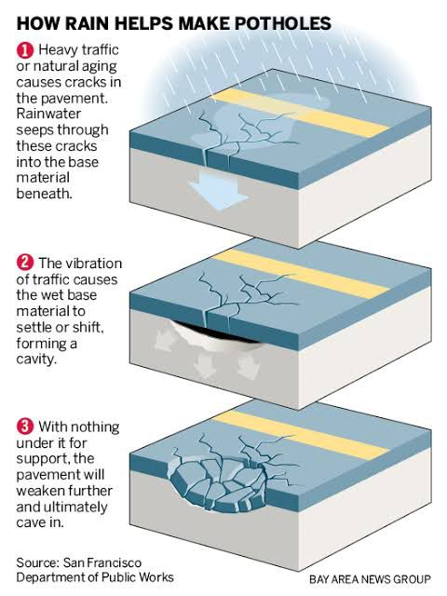
What causes Potholes?
Potholes are often caused by the expansion and contraction of ground water after the water has entered into the ground under the pavement.
As the weight of cars, trucks and other vehicles pass over the weak spot in the road, pieces of the roadway material weaken, which will cause the material to be displaced or broken down from the weight, creating the pothole.
e

Slide 3



Our Solution
We will perform data driven road assessments ensuring road safety, proper road maintenance and management.
Our aim is to use a large network of sensors and devices mounted onto everyday vehicles in order to implement a crowd-sourced data pool which can be used to detect, log and prioritise timely road repair.
We can achieve this by using ultrasonic sensors for measuring the distance of an object on the road surface. When it is detected the camera captures the images and with help of GPS, the geographic location is located. The data is stored in database which further used send the information to road authorities, which may take the appropriate action.

Slide 4
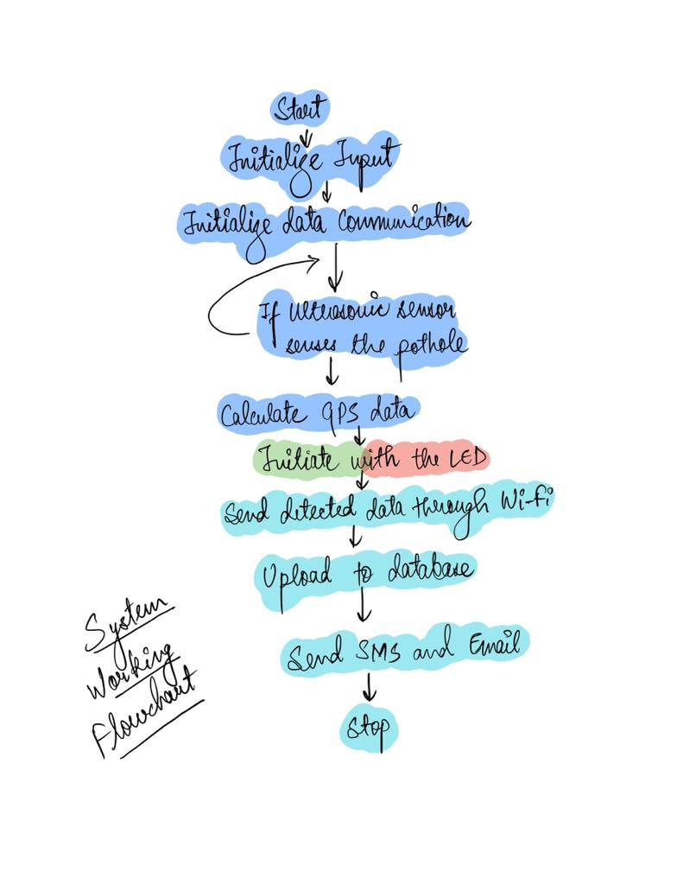
System Design
Exhibit - A
The System will make use of an array of sensors, all of which are designated to perform a different task each.
The sensor array collects the data and then the data is sent over to our network for storage, processing and evaluation

Slide 5
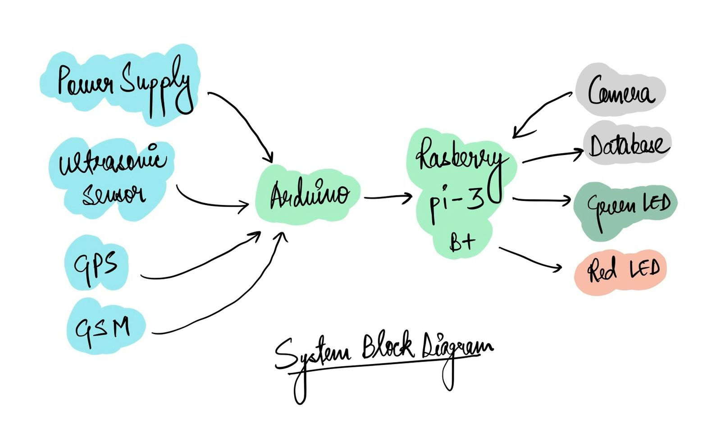
System Design
Exhibit - B
For local data, on-site data processing and refinement, we can make use of SBCs (Single Board Computers) like the famous Raspberry Pi
In a similar manner, an Arduino microcontroller board can be used to control and log data from the sensor array before it is sent over for processing…

Slide 6
Our Killer Feature
If usage of a sensor array is not viable or not cost effective, a user can even make use of their smartphone in order to collect and assess road data.
We can develop an app which will make use of a smartphone’s sensors (such as the Camera, the GPS location, even the Gyroscope) to acquire road data, process it and push it onto our servers.
This way, we can successfully map out a large chunk of India’s road network without the need of any extra hardware, just by using something that resides in all of our pockets these days…

Slide 7
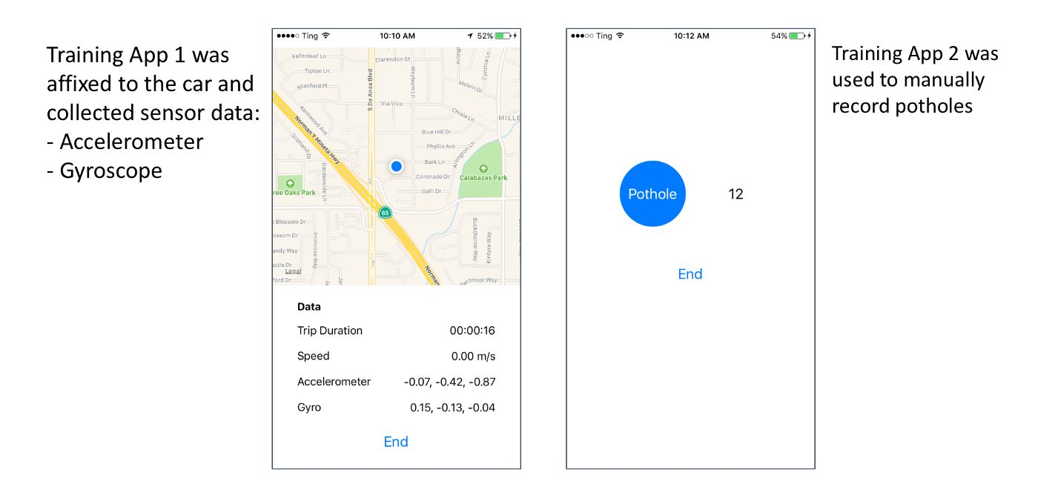
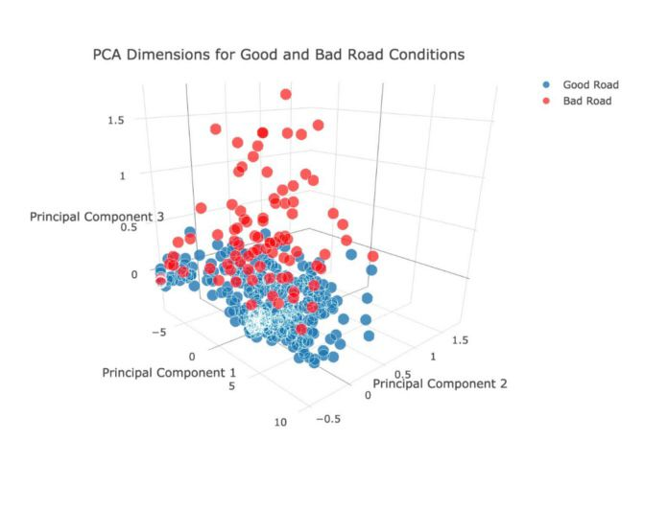
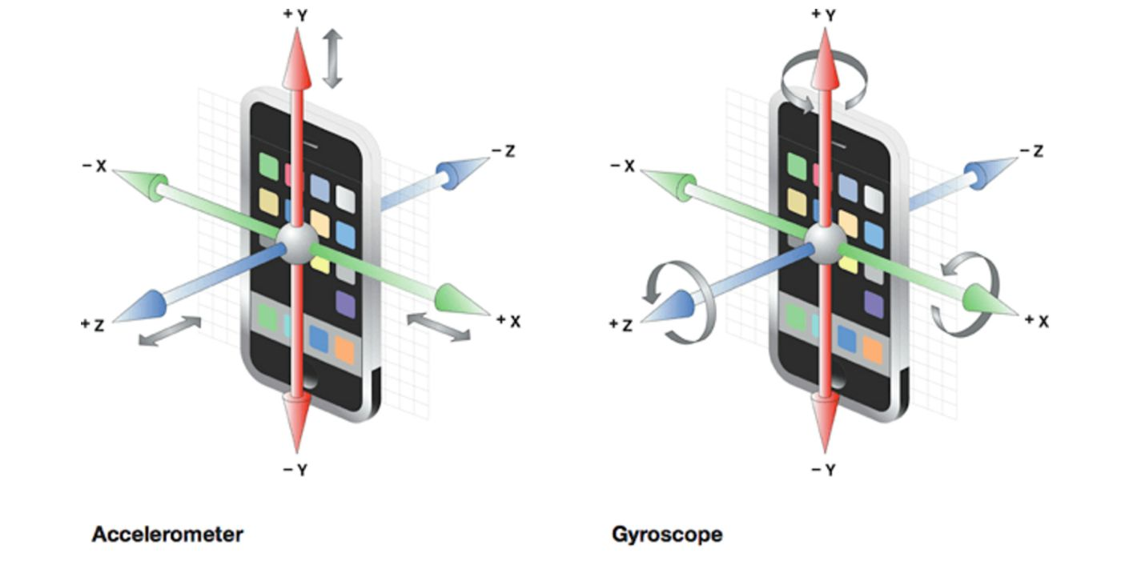
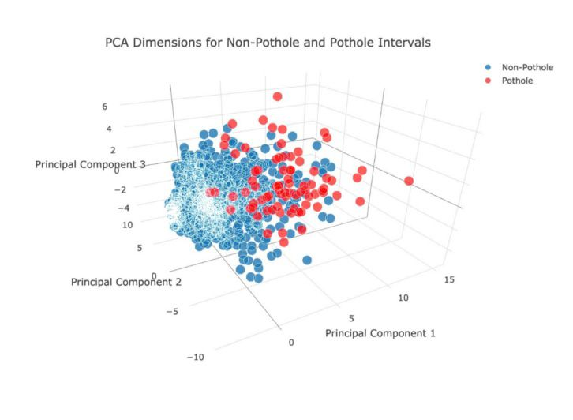
A Slight Teaser…

Slide 8
According to statistics, close to 10,000 people have lost their lives over the past three years due to pothole related road accidents.
We wish to make sure that no one looses their life over something which can be easily rectified.
Our Mission
We envision a nation where no man, woman or child has to loose their life as the result of a tragic road accident.

Slide 9
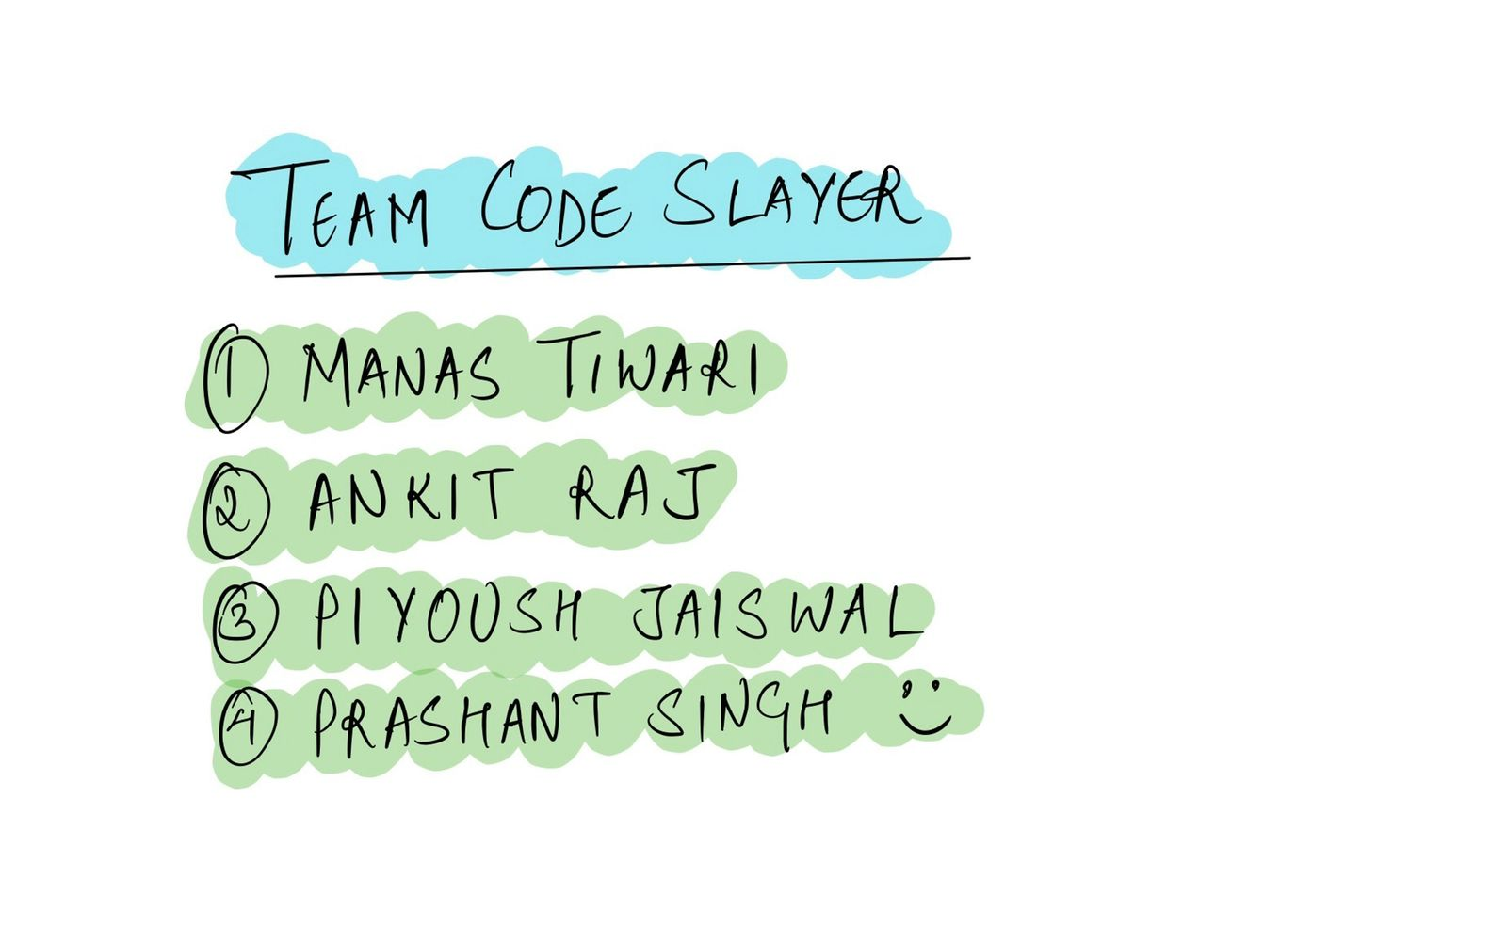

OUR TEAM

